Slide 1


Municipal Service and Sphere of Influence Reviews for Orange County Cemetery District
October 12, 2022

Slide 2
Recommended Actions
Receive and file the MSR for Orange County Cemetery District.
Approve OC LAFCO resolutions adopting the MSR and SOI Statements of Determinations and reaffirm the District’s SOI.
Adopt the Notices of Exemption for the District’s MSR and SOI in accordance with CEQA.

Slide 3
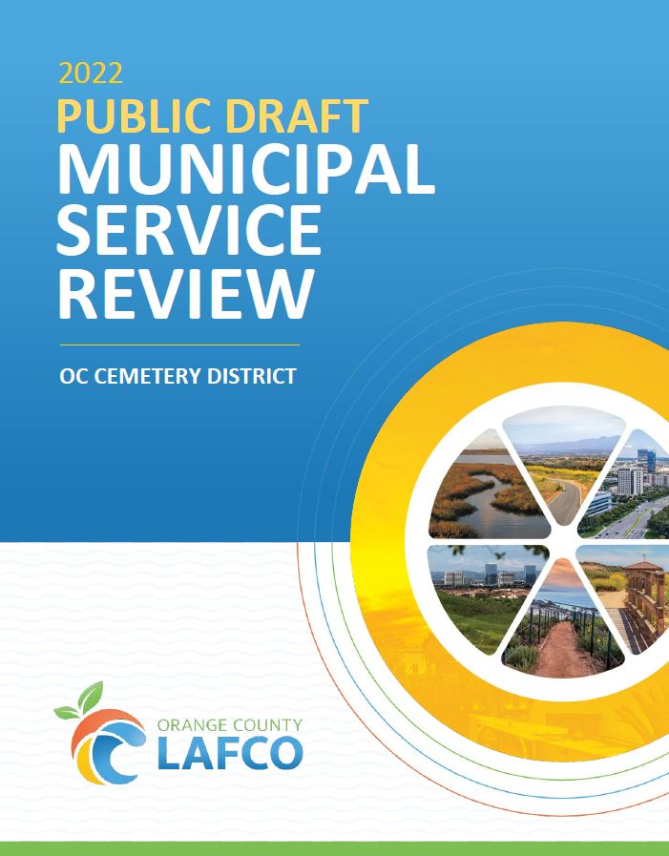
Background
Mandate from the State Legislature.
OCCD’s MSR included in current Work Plan.
MSR process involved a collaborative effort with District staff.
Douglass Davert
CHAIR

Slide 4
Overview of Orange County Cemetery District

Slide 5
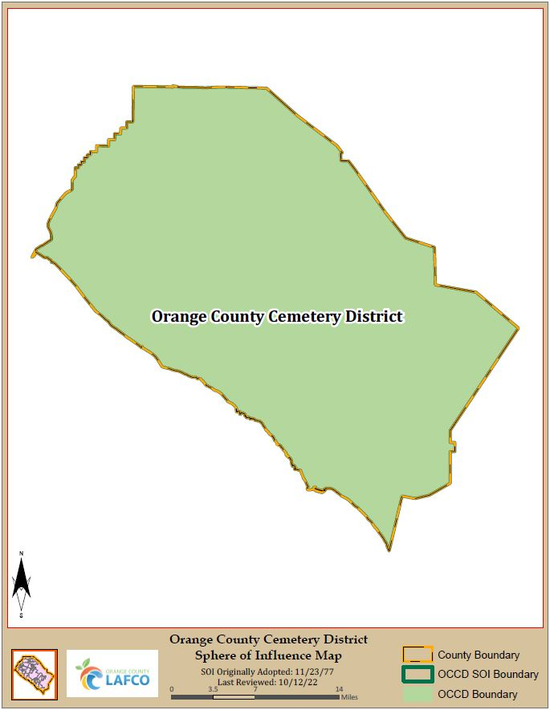
Orange County Cemetery District
Established in 1926.
Coterminous with the County boundary.
800 square miles.
Three Cemetery locations and a new cemetery scheduled to open 2025.

Slide 6
MSR and SOI Statements of Determinations

Slide 7
MSR Determinations (G.C. Section 56430)
Growth and population.
Disadvantaged unincorporated communities.
Present and planned capacity of public facilities, including needs or deficiencies.
Financial ability of agencies to provide the services.
Shared facilities and opportunities.
Governmental structure and operational efficiencies.
Any other matter related to effective or efficient service delivery.

Slide 8
SOI Determinations (G.C. Section 56425)
Present and planned land uses.
Present and probable need for public facilities and services.
Present capacity and adequacy of public facilities and services.
Social or economic communities of interest.
Facility or service needs of disadvantaged unincorporated communities related to sewers, municipal and industrial water.

Slide 9
MSR Determination Highlights
Growth and Population
OCCD projected to have to 6% increase by 2040.
Existence of Disadvantaged Unincorporated Communities
OCCD service boundary includes seven disadvantaged unincorporated communities receiving like services.

Slide 10
MSR Determination Highlights
Present and Planned Capacity of Public Facilities and Public Services
The District provides all types of interment services such as casket in-ground burials, niches, infant, urn, and cremation spaces.
All three cemeteries are at or nearing capacity for their respective services.
The addition of a fourth cemetery will address the District’s capacity issue for services.

Slide 11
MSR Determination Highlights
Financial ability of agencies to provide services.
The District is properly funded to provide the interment services to the residents.
The District is properly funded to maintain and operate the fourth cemetery.
Accountability for Community Service Needs
Governed by the Board of Trustees.
The District maintains an agency website that contains information for scheduled meetings, programs, and various services.

Slide 12
Recommended Actions
Receive and file the MSR for Orange County Cemetery District.
Approve OC LAFCO resolutions adopting the MSR and SOI Statements of Determinations and reaffirm the District’s SOI.
Adopt the Notices of Exemption for MSR 21-11 and SOI 21-12 in accordance with CEQA.

Slide 13
Public Hearing & Commission Discussion

