Slide 1

Proposed “Santa Margarita Water District Annexation of the City of San Juan Capistrano Water and Wastewater Utilities” (DA20-01)
August 19, 2021

Slide 2



COMMISSION CONSIDERATION
  Approval of the Proposed Annexation of the City of San Juan Capistrano Water and Wastewater Utilities to the Santa Margarita Water District.

Slide 3
“HOW DID WE GET HERE?”
  2015 - City of San Juan Capistrano began exploring the divestiture of the water and wastewater utilities.
  2018 – Focused MSR Completed identifying the possible options for successor agencies and identified areas of improvements to the City of San Juan Capistrano Water and Wastewater Utility Systems.
  2020 - Santa Margarita Water District submitted the application for the proposed annexation.

Slide 4

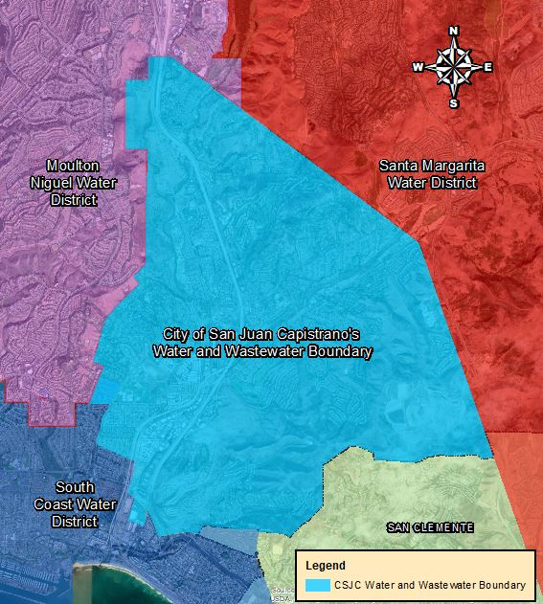

City of San Juan Capistrano’s Water and Wastewater Systems
Service Boundary
  Square Miles: 14
  Population: 36,262
Land Use:
  Residential, Commercial, Open Space, and Agricultural.

Slide 5
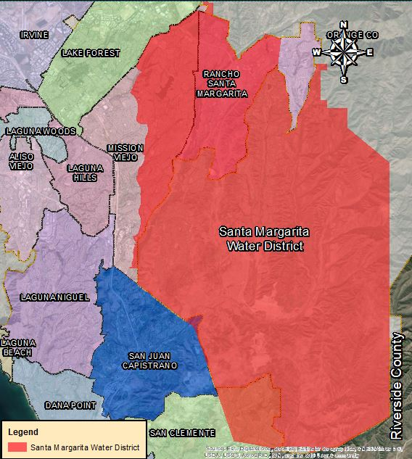
Proposed Successor Agency:
Santa Margarita Water District
Service Boundary
  City of Rancho Santa Margarita
  Portions of the Cities of Mission Viejo and San Clemente.
  Coto de Caza, Ladera Ranch, Las Flores, Stonecliffe, Wagon Wheel, and Rancho Mission Viejo.
Service Population:165,000

Slide 6

THE PLAN FOR SERVICE
Proposes to:
  Continue current levels of water and wastewater services without interruption.
  Immediately begin infrastructure improvements and upgrades.
  Stabilize the water and wastewater rates.
  Enhance water reliability within proposed annexation area.

Slide 7
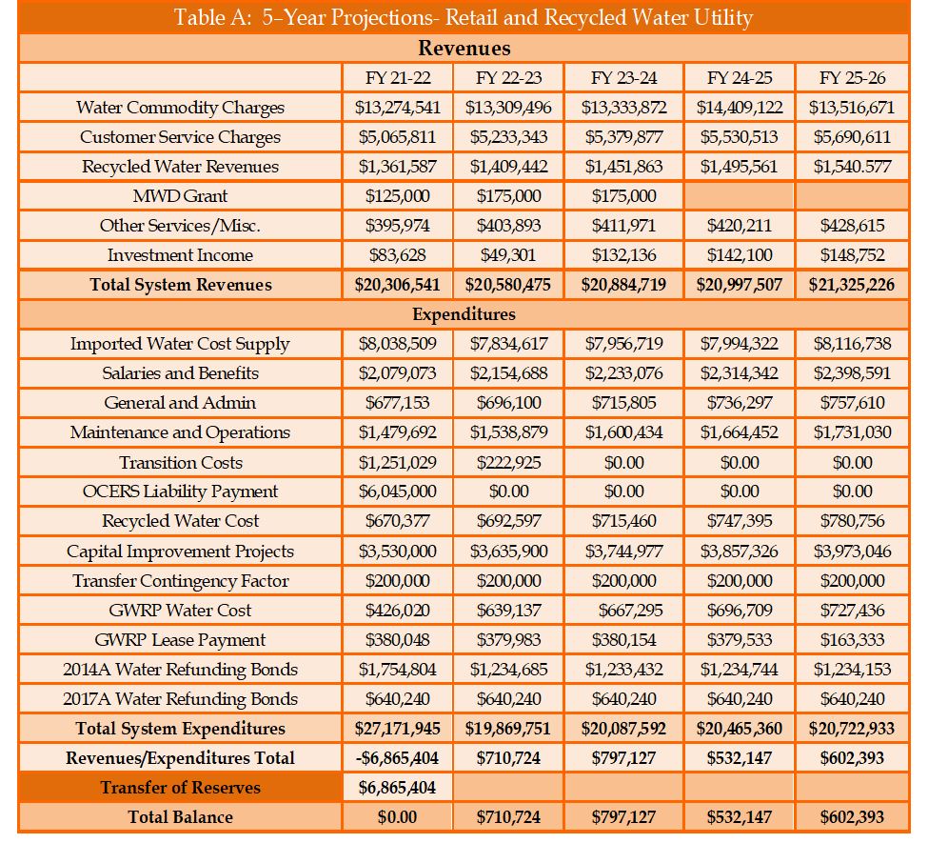
Financing of Water Service Delivery
Transition Year One(FY 2021-22):
Expenditures of $27.2M projected to exceed Revenues of $20.3 million.
Shortfall of $6.8M to be covered through reserve fund.
Revenues and expenditures stabilize in future years.

Slide 8
Financing of Wastewater Service Delivery
Transition Year One(FY 2021-22):
Expenditures of $10.3M projected to exceed Revenues of $9.7 million.
Shortfall of $581K to be covered through reserve fund.
Significant improvements to the infrastructure.
Exceeded expenditures in future years to be funded by reserves and bonds/loans.

Slide 9
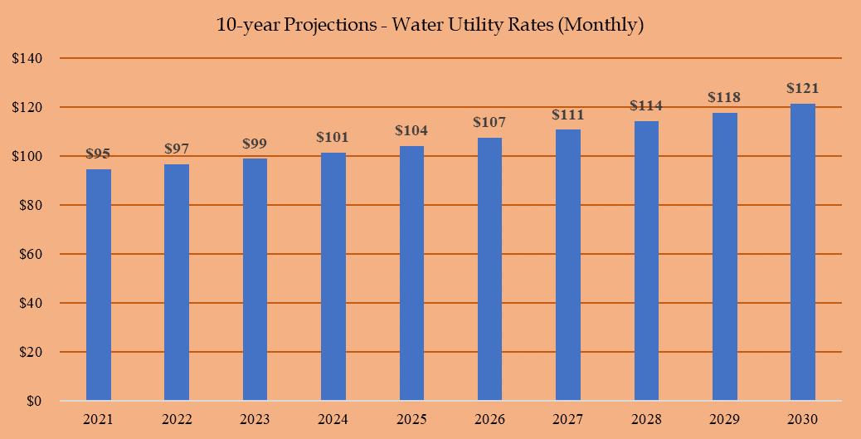
STABILIZATION OF UTILITY RATES - Water
Generate revenue to offset operational expenditures, CIP and reserve fund.
Current average rate of $99 decreases to $95 per household.
Projected increases over next 10 years of $2 to $4 per household.

Slide 10
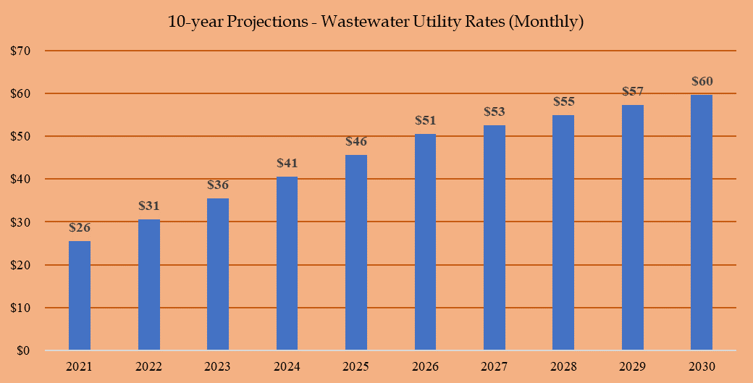
STABILIZATION OF UTILITY RATES - Wastewater
Generate revenue to offset operational expenditures, CIP, and reserve fund.
Current monthly average rate of $26 will be maintained during first year.
Increase of $5 per household.
Increased expected to lower in future years.

Slide 11
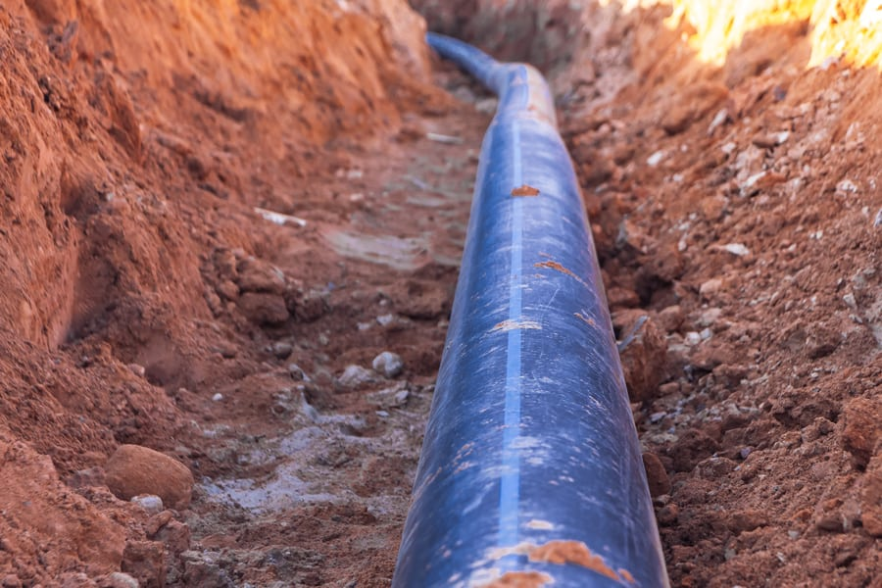
INFRASTRUCTURE IMPROVEMENTS AND UPGRADES
Water Utility
  Approximately $22M over next five years.
  Replacement and realignment to pipelines and pump stations.
Wastewater Utility
  Approximately $18.7M over next five years.
  Replacement and upgrades to sewer mains and lift stations.

Slide 12

WATER RELIABILITY
Increased dependency on local water supplies.
  Recycled water opportunities.
Integration of District Projects (Ground Water Recovery Plant, Cadiz Groundwater Project, San Juan Watershed)

Slide 13
SUMMARY
SMWD’s POS:
  Provides long-term financing to continue water and wastewater service levels.
  Immediately begins infrastructure improvements and upgrades.
  Reduces and stabilizes utility rates.
  Enhances reliability on local water supplies.

Slide 14
RECOMMENDED ACTIONS
Adopt the LAFCO Resolution No. DA20-01 approving the Santa Margarita Water District Annexation of the City of San Juan Capistrano Water and Wastewater Utilities.
Set a 30-day protest period and authorize the Executive Officer to conduct protest proceedings pursuant to Government Code Section 57000.

Slide 15

Public Hearing
&
Commission Discussion/Questions

Slide 16
Request by Aera Energy for the “Tonner Hills Annexation Extension”
August 19, 2021

Slide 17
Recommended Action
Adopt the LAFCO Resolution approving the “Tonner Hills Annexation Extension.”

Slide 18
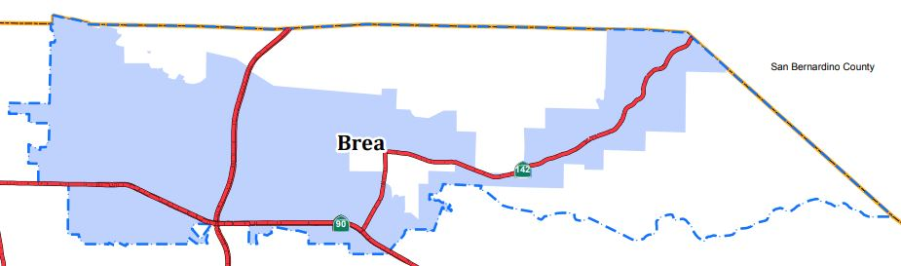
Background
Approved in 2005.
Two Key Areas:
  A large area successfully annexed into the City.
  Remaining area delayed for 15 years.

Slide 19
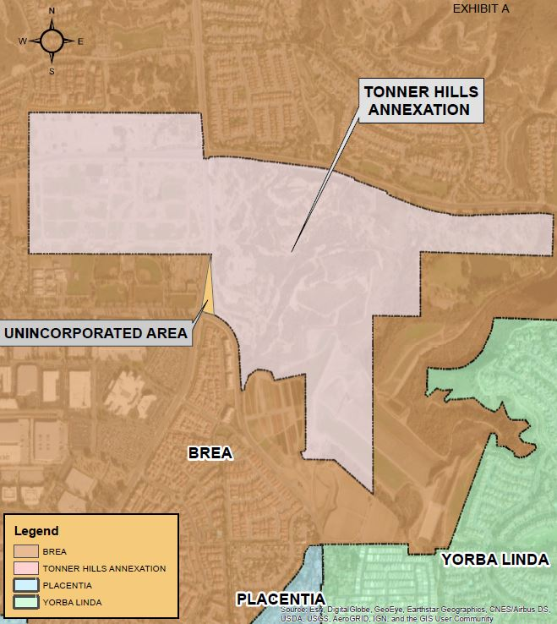
Location:
City of Brea’s Sphere of Influence
Located South of Lambert Road and East of Valencia Ave
Approximately 290 Acres

Slide 20

Background Continued
Notice
Recordation Deadline of the remaining area September 29, 2021.
Project Delays
Entitlement Process
Pandemic
Request Letter
Aera Energy requested a one-year extension to the recordation deadline- September 29, 2022.

Slide 21
Recommended Action
Commission has authority to extend deadline.
Adopt the LAFCO Resolution No. CA 03-12A approving the “Tonner Hills Annexation Extension.”

